Slide 1
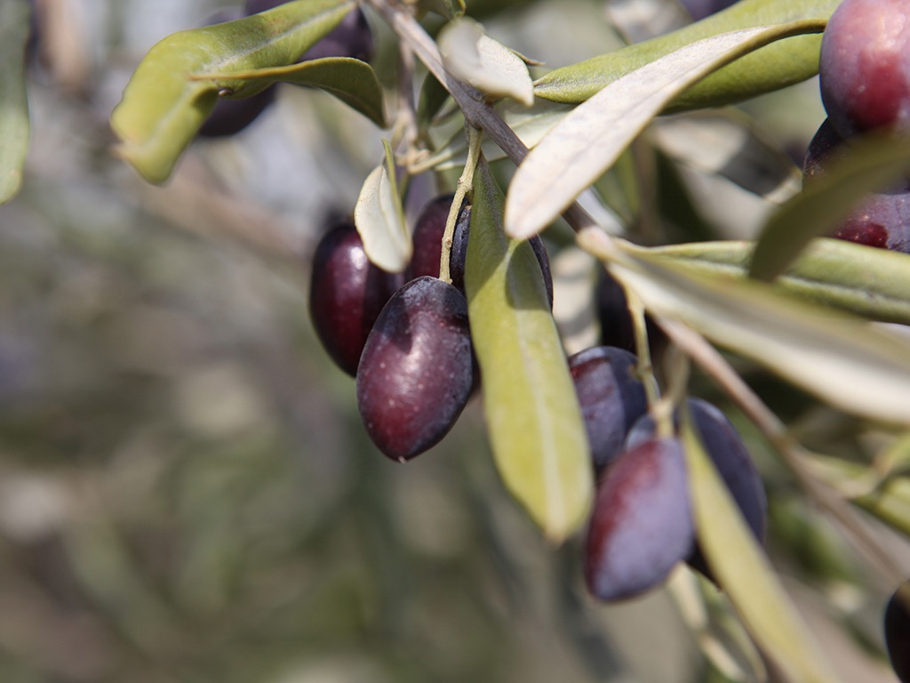
Notes:
http://www.freebibleimages.org/stories/?theme=Olive%20press

Slide 2
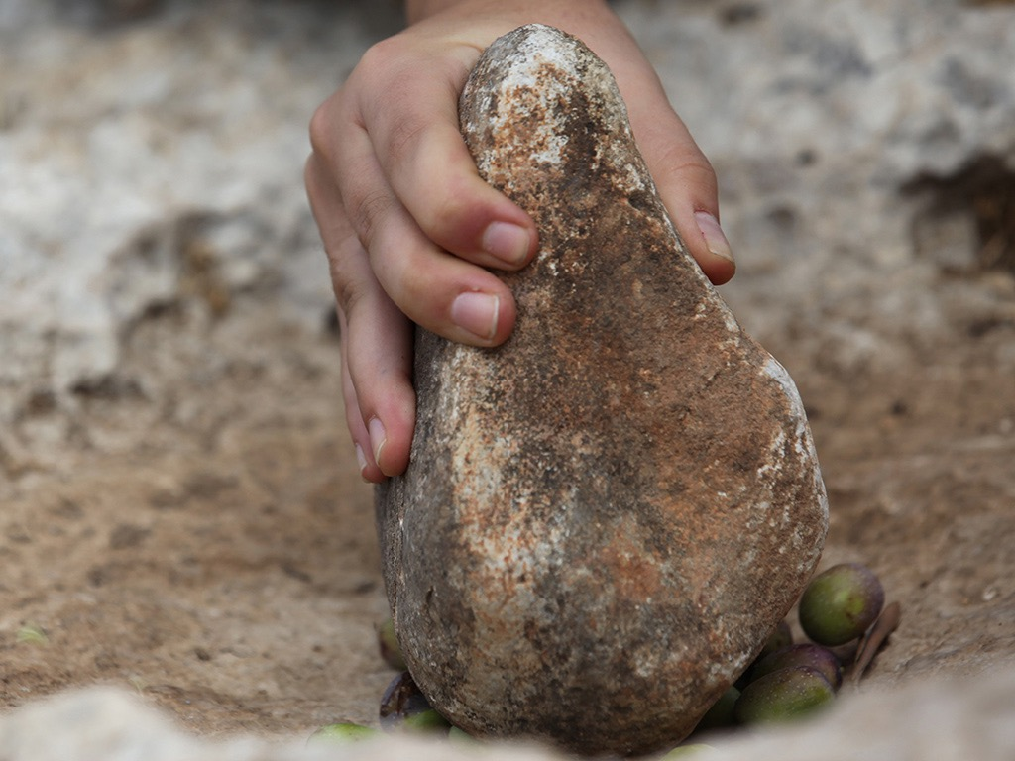
Notes:
http://www.freebibleimages.org/stories/?theme=Olive%20press

Slide 3
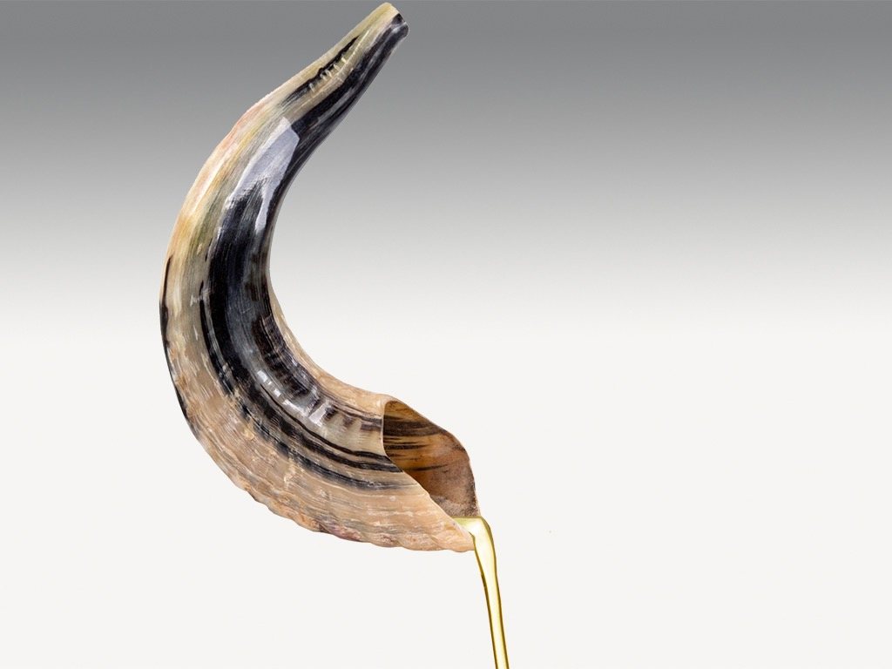
Notes:
http://www.freebibleimages.org/stories/?theme=Olive%20press

Slide 4
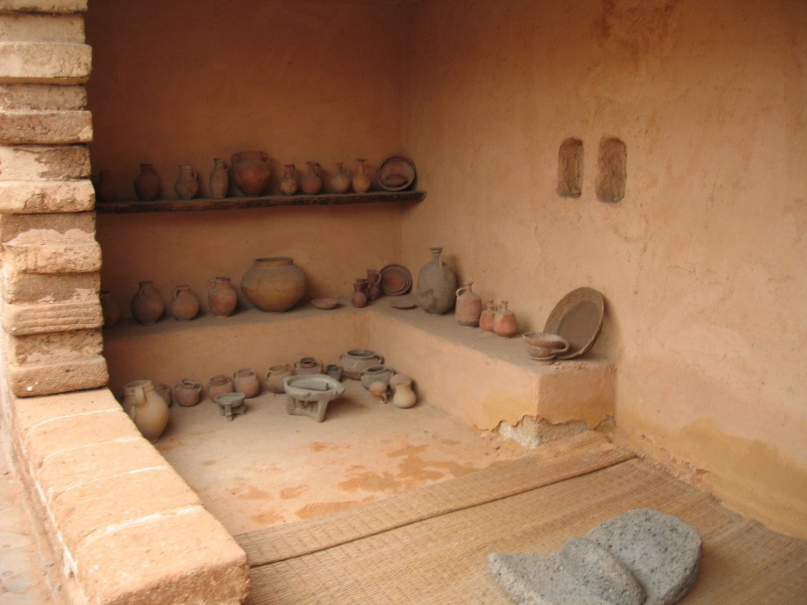
Notes:
http://www.freebibleimages.org/stories/?theme=Olive%20press

Slide 5
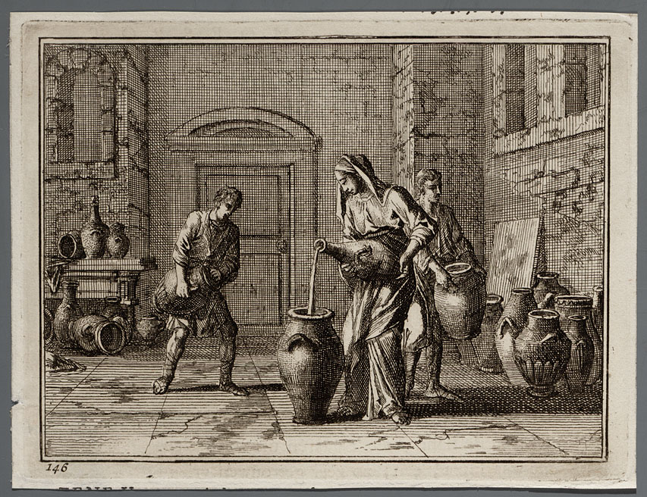
Notes:
http://www.geheugenvannederland.nl/nl/geheugen/view?coll=ngvn&identifier=AHM01%3AA_50841 Copyright checken!

